Slide 1
Title: DES (Data Encryption Standard) Implementation
Quantum Cryptography and Coding Sumit Kumar(M23IQT007)
11/05/2024

Slide 2
Introduction
- DES (Data Encryption Standard) is a widely used symmetric-key encryption technique - Developed in the 1970s by IBM and adopted by the U.S. government - Used for securing sensitive data during transmission and storage

Slide 3
How DES Works
- Takes a plaintext message and a secret key as input
- Divides the plaintext into 64-bit blocks
- Performs 16 rounds of operations on each block, involving:
- Permutation (rearranging bits)
- Substitution (replacing bits using predefined tables)
- Key mixing (combining the block with the round key)
- Produces an encrypted ciphertext as output

Slide 4
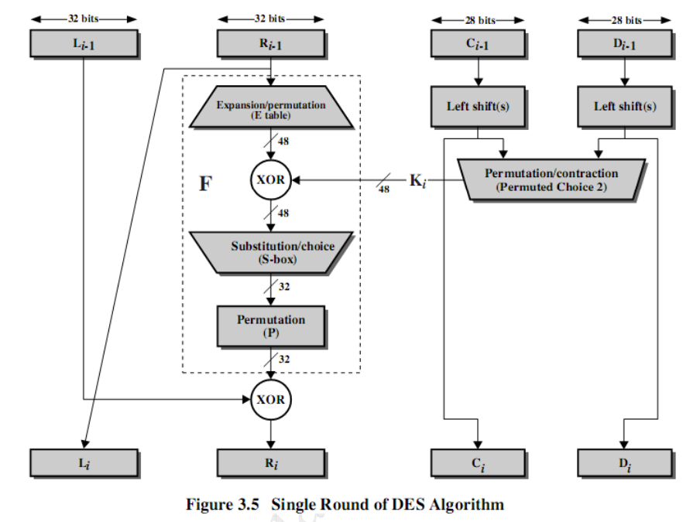

Slide 5
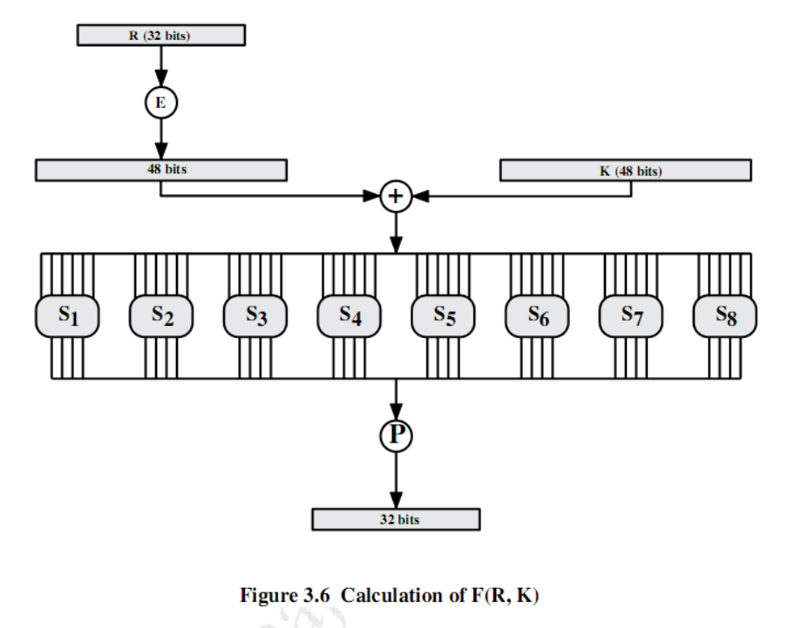

Slide 6
Expansion Permutation Table (expansion_permutation):
Maps 32 bits to 48 bits in DES encryption.
S-boxes (s_boxes):
Eight substitution boxes for non-linear substitutions.
P-box Transposition Table (p_box_transposition):
Rearranges bits after S-box substitution.
generate_round_key():
Creates a unique 48-bit round key for each round.
expand_to 48_bits(right_half):
Expands 32-bit input to 48 bits.
substitute_with_s_boxes(expanded_half_block):
Substitutes using S-boxes.
transposition_p_box(output):
Permutes output bits.
single_round_des(right_half, round_key):
Encapsulates one round of DES.
Example usage:
Generates input and round key, performs one DES round, and prints result.

Slide 7
Key Features of the Implementation
- Converts plaintext to binary representation
- Generates 16 round keys from the secret key
- Includes helper functions for permutation, substitution, and key generation
- Performs 16 rounds of operations on each 64-bit block
- Produces an encrypted ciphertext as output

Slide 8
Example Usage
Plaintext: "Hello, World!"
Secret Key: "This is a key!"
Encrypted Message (Binary):
[Binary representation of the encrypted message]

Slide 9
Code Overview
- Main function: des_encrypt
- Takes plaintext, key, and constants as input
- Generates round keys
- Performs 16 rounds of operations on each block
- Helper functions:
- permute: Permutes (rearranges) bits
- substitute: Substitutes bits using S-boxes
- generate_round_keys: Generates round keys from the secret key
- single_round_DES: Performs operations for a single round

Slide 10
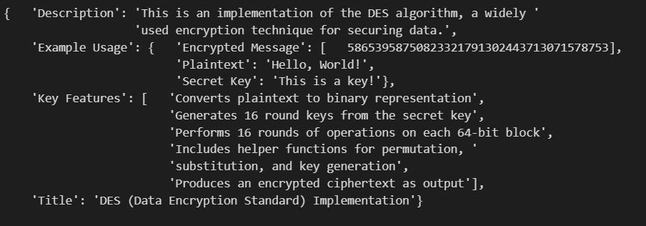

Slide 11
Conclusion
- Implemented the DES algorithm in Python
- Includes helper functions for various operations
- Converts plaintext to encrypted ciphertext
- Can be used for secure data transmission and storage

Slide 12
Code Link :- https://github.com/Sumitkumar-curio/Fiestal-Cipher

